Slide 1


Wellcome To Ethical Hacking class 2nd Week Day 3rd

Slide 2

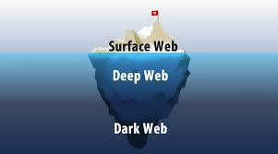
Deep Web and Dark Web Information Gathering
Definition:
Deep Web: The part of the internet that is not indexed by standard search engines. It includes private databases, web forums, subscription services, and other content that requires specific credentials or permissions to access.
Dark Web: A subset of the Deep Web that is intentionally hidden and accessible only through specialized software such as Tor. It is often associated with illegal activities but also used for privacy and anonymous communication.

Slide 3

Deep Web and Dark Web Information Gathering
Examples:
Deep Web: Academic databases like JSTOR or paid subscription services like Netflix, which are not accessible through standard search engines.
Dark Web: Darknet markets where illegal goods and services are bought and sold, or anonymous forums for whistleblowers and activists.

Slide 4

Deep Web and Dark Web Information Gathering
Techniques:
Using Specialized Search Engines:Tools like Ahmia and Deep Web Technologies can help locate content within the Deep Web.
Utilizing Tor for Dark Web Access:Tor (The Onion Router) provides access to .onion sites on the Dark Web, ensuring anonymity and encryption.

Slide 5

Deep Web and Dark Web Information Gathering
Tools/Websites:
Ahmia: A search engine designed to index .onion sites accessible via Tor.
Deep Web Technologies: Offers federated search solutions to find information in the Deep Web across multiple databases.

Slide 6



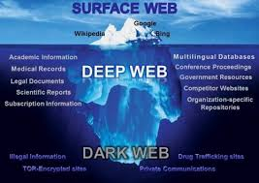
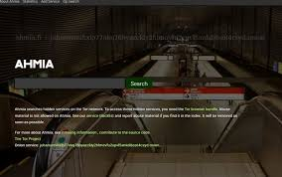
Deep Web and Dark Web

Slide 7


Tor and Onion Sites Exploration
Definition:
Tor: A free and open-source software for enabling anonymous communication by directing internet traffic through a volunteer overlay network.
Onion Sites: Websites with a .onion suffix that can only be accessed via the Tor network, providing enhanced privacy and anonymity.

Slide 8

Tor and Onion Sites Exploration
Examples:
Tor Browser:A web browser specifically designed to use the Tor network, allowing users to access .onion sites and browse the internet anonymously.
ProPublica’s Onion Site: An example of a legitimate news organization hosting an .onion site to provide anonymous and secure access to their content.

Slide 9
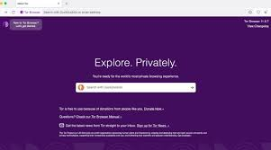
Tor and Onion Sites Exploration
Techniques:
Installing and Using Tor Browser: Download the Tor Browser from the official Tor Project website and use it to access .onion sites.
Exploring Directories of Onion Sites: Use directories like The Hidden Wiki to find and explore .onion sites on the Dark Web.

Slide 10
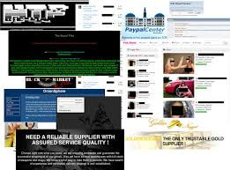
Tor and Onion Sites Exploration
Tools/Websites:
Tor Browser: The primary tool for accessing the Tor network and .onion sites.
The Hidden Wiki: A directory listing various .onion sites, including both legal and illegal content.

Slide 11
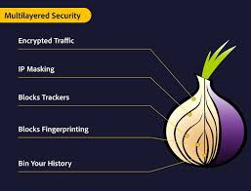
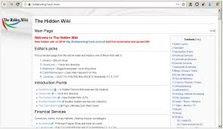
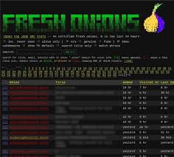
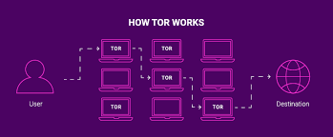
Tor and Onion Sites Exploration

Slide 12


Threat Intelligence Feeds
Definition:
Threat Intelligence Feeds: Streams of data that provide information about potential or current threats to an organization's cybersecurity. These feeds help in identifying, analyzing, and responding to cyber threats in real time.

Slide 13

Threat Intelligence Feeds
Examples:
AlienVault OTX: An open threat intelligence community that provides access to real-time threat data and indicators of compromise (IOCs).
IBM X-Force Exchange: A threat intelligence platform that offers threat data, insights, and reports from security experts.

Slide 14

Threat Intelligence Feeds
Techniques:
Integrating Threat Feeds into SIEM:Security Information and Event Management (SIEM) systems can consume and analyze data from threat intelligence feeds to detect and respond to threats.
Utilizing APIs for Automation: Use APIs provided by threat intelligence platforms to automate the ingestion and processing of threat data.

Slide 15

Threat Intelligence Feeds
Tools/Websites:
AlienVault OTX: Offers access to a collaborative platform for sharing threat intelligence.
IBM X-Force Exchange: Provides threat intelligence reports and data that can be integrated into security operations.

Slide 16


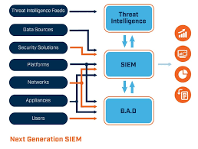
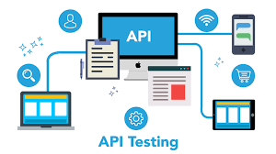
Threat Intelligence Feeds

Slide 17

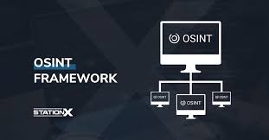
OSINT Frameworks and Tools
Definition:
OSINT (Open Source Intelligence): The process of collecting and analyzing publicly available information for intelligence purposes. It involves gathering data from open sources such as websites, social media, and public records.

Slide 18
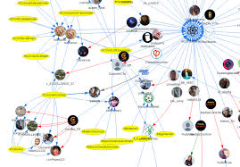
OSINT Frameworks and Tools
Examples:
Investigating Social Media Profiles:Using OSINT techniques to gather information from public social media profiles for background checks or investigations.
Analyzing Domain Information: Gathering data on domain registrations, DNS records, and website content to assess the legitimacy and history of a domain.

Slide 19

OSINT Frameworks and Tools
Techniques:
Using OSINT Frameworks: Utilize comprehensive frameworks like the OSINT Framework to systematically gather and organize open source information.
Employing Advanced Search Queries: Use advanced search operators in search engines to find specific information more efficiently.

Slide 20

OSINT Frameworks and Tools
Tools/Websites:
Maltego: A data visualization tool that helps in gathering and connecting information from various sources.
Shodan: A search engine for internet-connected devices, providing information on exposed systems and vulnerabilities.

Slide 21


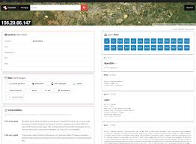
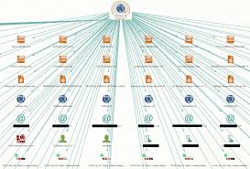
OSINT Frameworks and Tools

Slide 22


Muhammad Bilal

Slide 23

Happy Hacking

Slide 24
Thank You!

